Slide 1
Housing prices
By: Sam Jones

Slide 2
Background
546 rows and 13 columns
Some of the numerical columns are how many bedrooms, how many bathrooms, and the price of the house
Some categorical columns are on the main road or not, has air conditioning, and if it has a basement or not

Slide 3

Goal
Looked at houses that have been sold recently and want to but my house up for sale. I want to predict what my house could go for with the graphs that I made

Slide 4
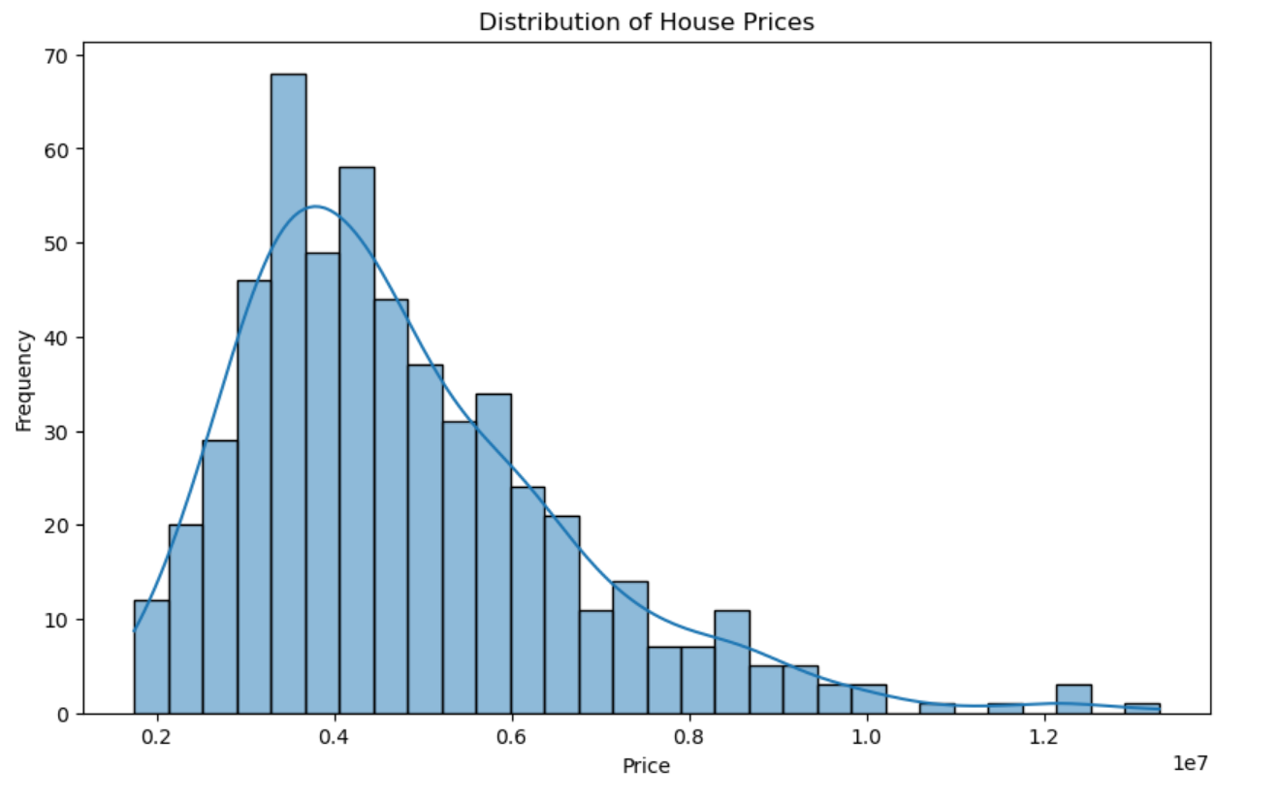
Distribution of house prices
Helps identify skewness (if most houses are lower-priced but some are very expensive).
Useful to understand the spread and central tendency of prices.

Slide 5
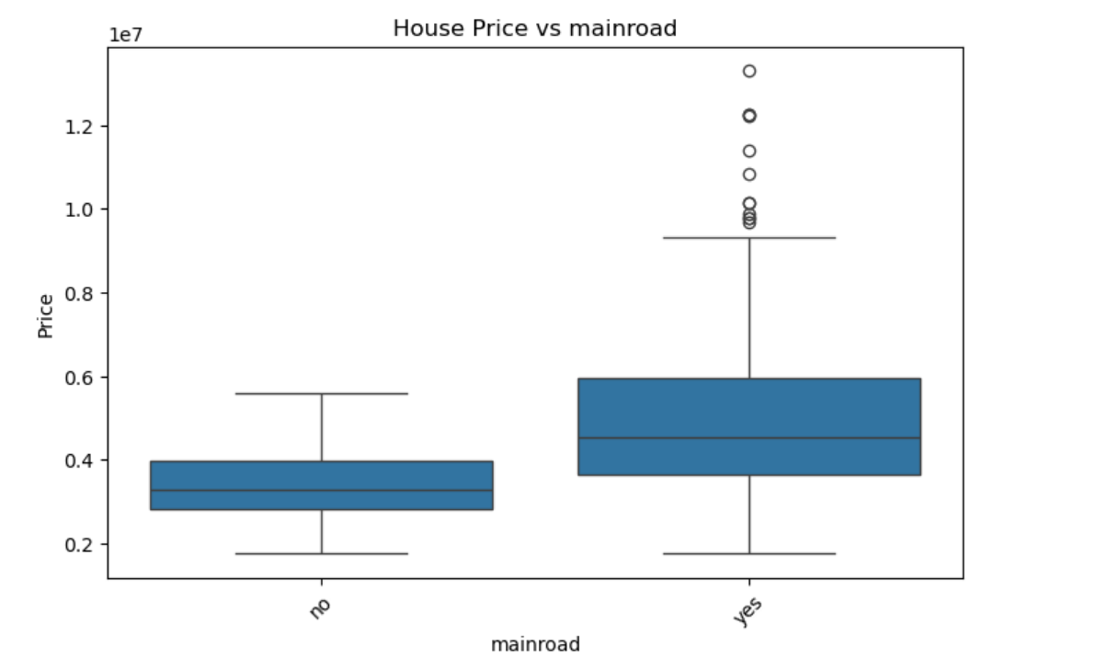
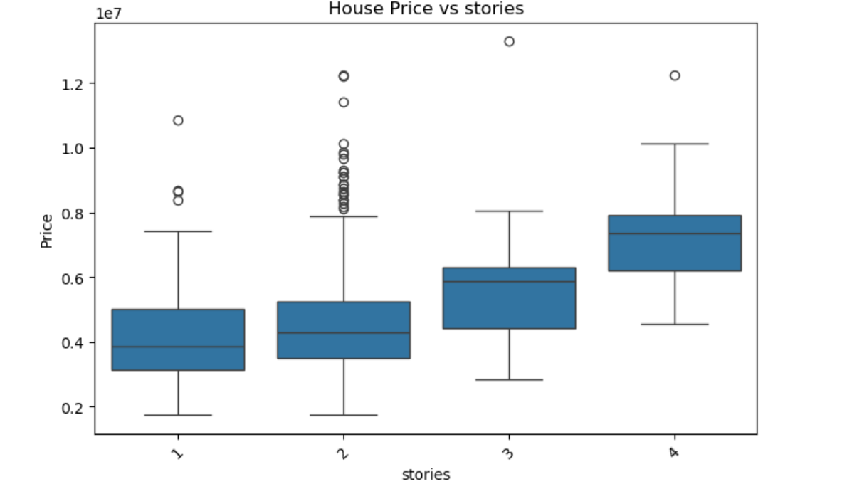
# 2. Boxplots for categorical features vs. price

Slide 6
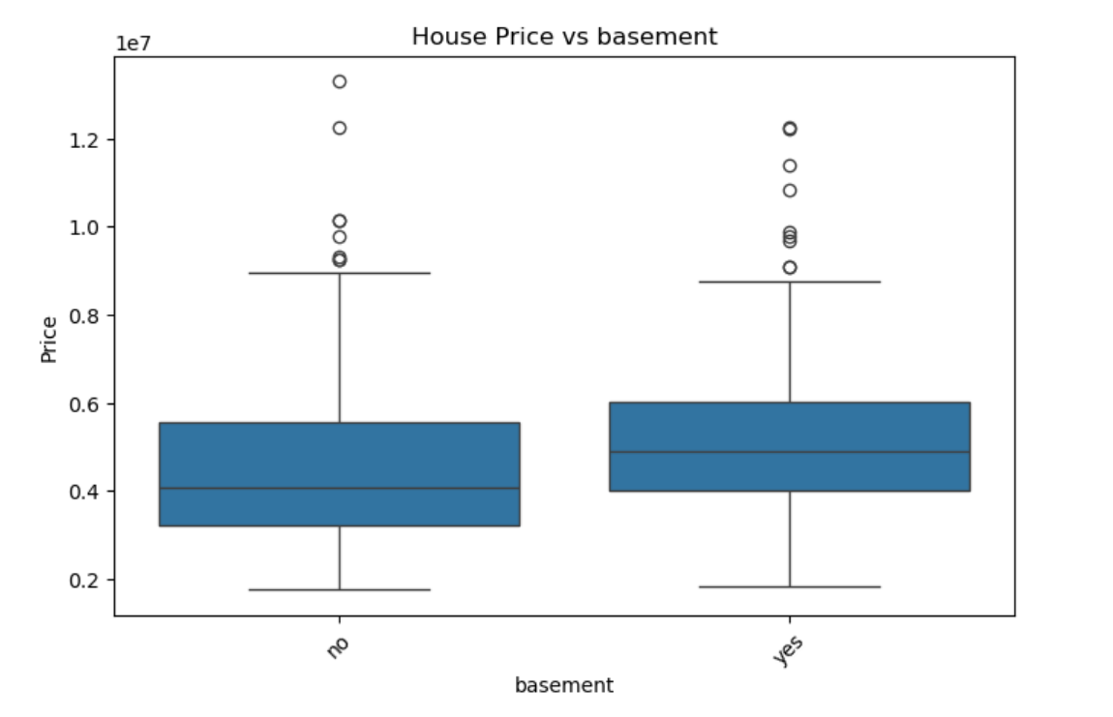
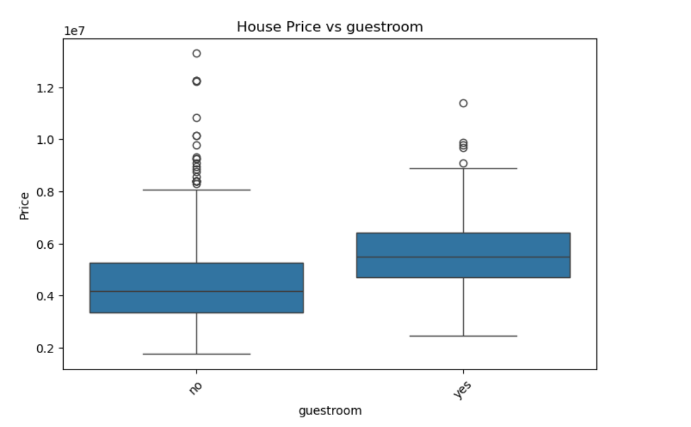
# 2. Boxplots for categorical features vs. price (continued)

Slide 7
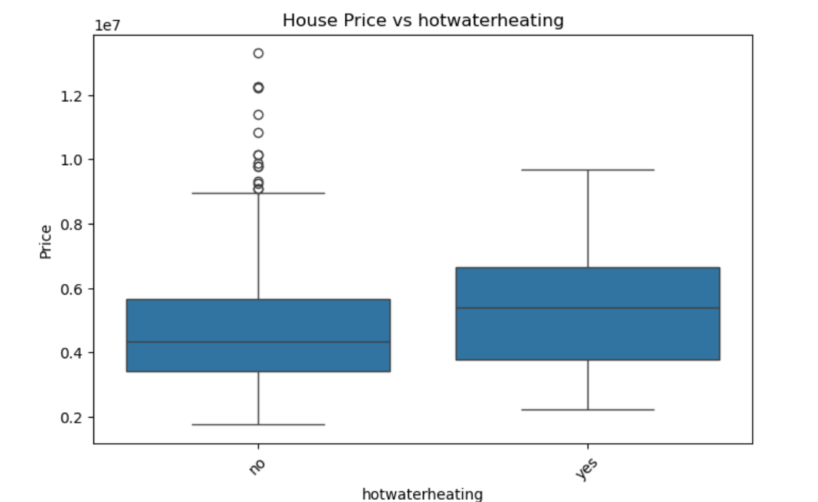
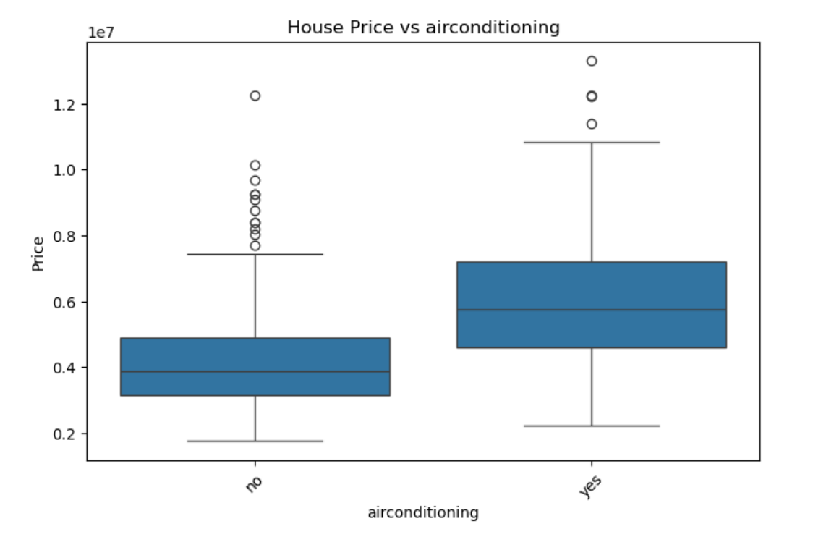
# 2. Boxplots for categorical features vs. price (continued)

Slide 8
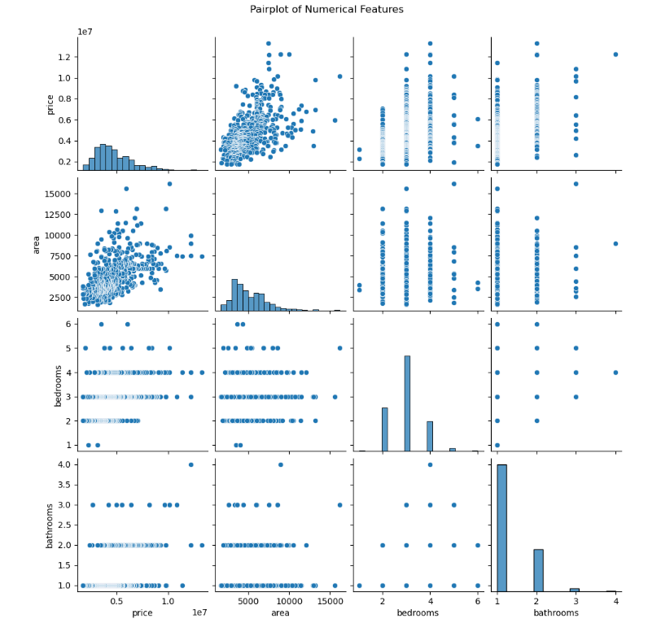
# 3. Pairplot for numerical features
Helps you see correlations or linear relationships between features and price.
For example, if area has a strong upward trend with price, it’s likely a strong predictor.

Slide 9
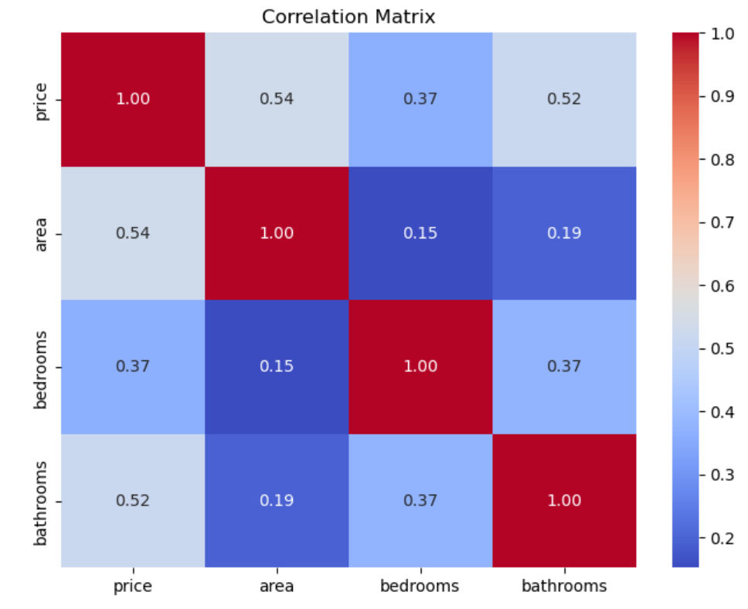
# 4. Correlation heatmap
A color-coded matrix showing correlation coefficients (from -1 to +1) between numerical variables.
Helps spot necessary features (if bedrooms and area are highly correlated, using both may be a factor).

Slide 10

Conclusion
If my house had more square footage, then I would get more money out of it. Also, this is a try with bathrooms. So if I were trying to sell my house, I would try and improve in these areas so that I could get the most money for my house

